Slide 1
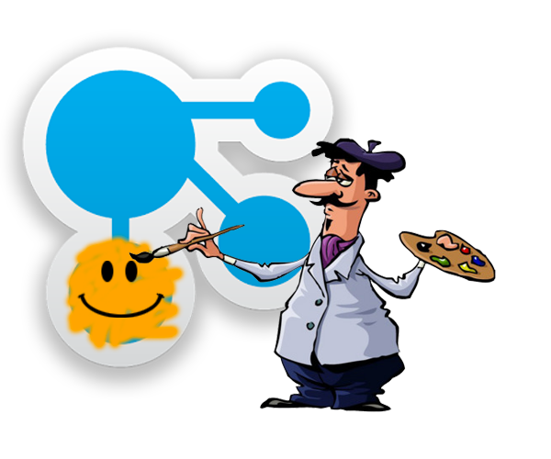
What you need to know about Connections Customizer
Scott Good
NA Above-Market Technical Sales SME

Slide 2
The problem we’re trying to solve…
Connections is hard to modify for either
Different look-and-feel (UI)
Enhanced functionality
With the right skills, can be done for on-prem
Very limited options for Connections Cloud
Customizer gives us a way to add…
JavaScript
CSS
Images
Other kinds of files…
…to change how Connections looks and works

Slide 3

What is Customizer?
A new capability in Connections
Based on…
Who the user is
Or what the web page is
(Or combinations of both)
Customizer adds one or more JavaScript files to the page as it is being sent back to your browser
(this is the part that matters)

Slide 4


How it works
Diane’s browser requests a Connections page from the server
The server figures out what files are required for that page and sends them back (html, css, javascript, etc)
HTML/CSS/JS
Diane’s browser uses those files to organize, format, and
display all the things she sees
on the web page

Slide 5

How it works
Diane’s browser requests a Connections page from the server
The server figures out what files are required for that page and sends them back (html, css, javascript, etc)
HTML/CSS/JS
Diane’s browser uses those files to organize, format, and
display all the things she sees
on the web page
The server also says “hey, this is Diane…I have a special rule for her” and sends one or more extra JavaScript and/or CSS files to the browser
JS/CSS for Diane
Illustrations courtesy of all-free-download.com

Slide 6

How it works
Diane’s browser requests a Connections page from the server
The server figures out what files are required for that page and sends them back (html, css, javascript, etc)
HTML/CSS/JS
This part is Customizer!
The server also says “hey, this is Diane…I have a special rule for her” and sends one or more extra JavaScript and/or CSS files to the browser
Diane’s browser uses those files to organize, format, and
display all the things she sees
on the web page
JS?CSS for Diane
Illustrations courtesy of all-free-download.com

Slide 7
That’s all…?
Yes. And…well…no.
The JavaScript and CSS added to the page by Customizer can do all kinds of things
Make minor or major changes to the overall look and feel of (most parts of) Connections
Modify or hide existing page elements
Add new elements to the page
Retrieve data from elsewhere…even outside Connections for…
Addition of outside content
Personalization information/instructions
Whatever else you can dream up
Someday Customizer may be able to make server-side modifications…but not today
Details here: https://www.ibm.com/developerworks/collaboration/library/customizer-intro/index.html

Slide 8
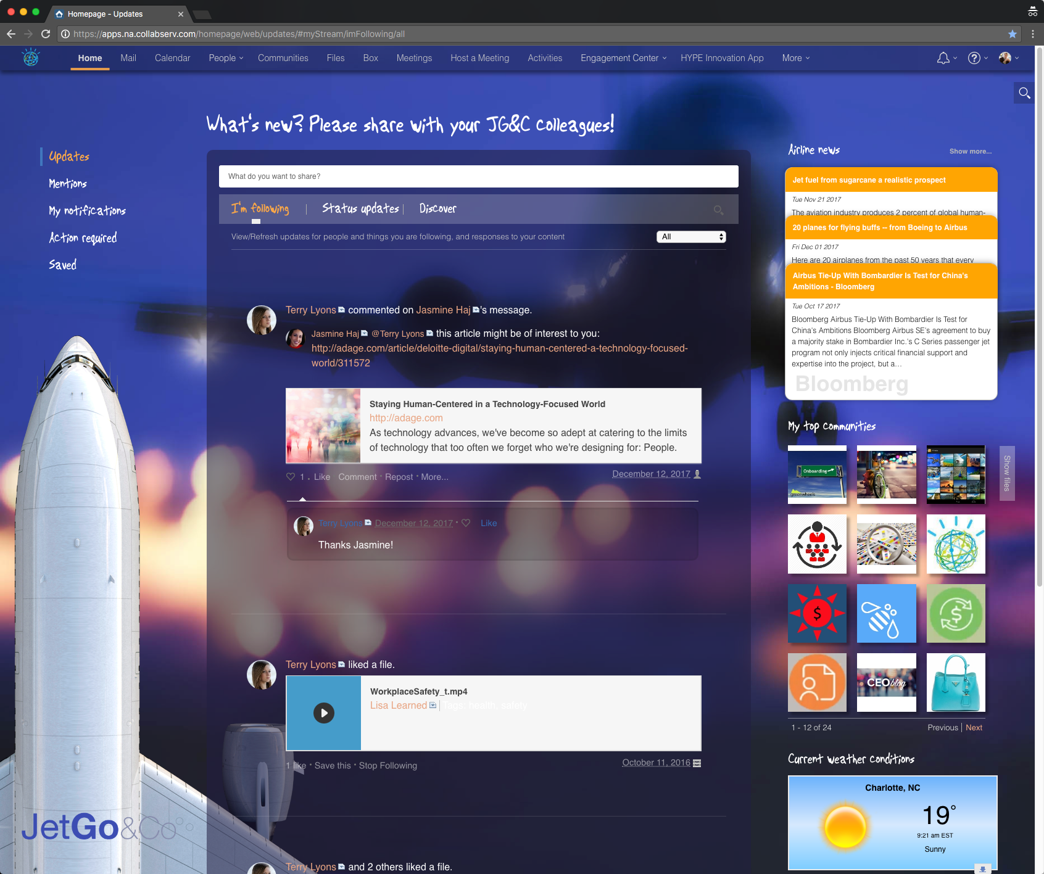
“Airplane UI”
Applies to homepage only
All of Apple UI changes
New color theme, background image, animated background (the jet)
Text labels replaced with images (to get script look)
Logo added bottom left
Communities/files flipper
Airline news is a live external query
Outside widgets were added
Weather, stock prices
Uses cookies
To remember airline stock selected

Slide 9
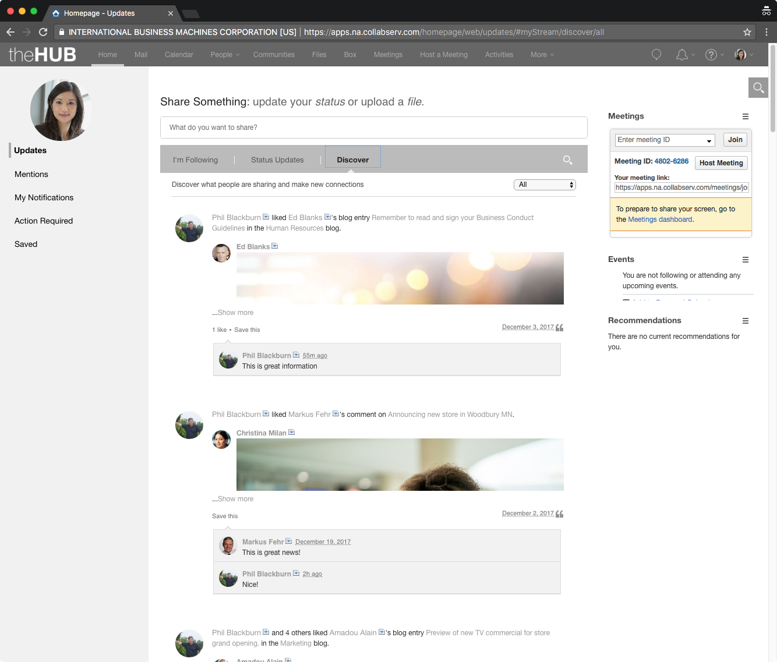
“ICEC UI”
Uses Customizer to match the look-and-feel of Connections to a modified ICEC UI
Changes colors and fonts
Retains much of the Connections layout (but that could be changed, too)
Cannot change some pages (yet)
Mail
Calendar
Meetings
Box
BUT, it improves the overall experience when users exit ICEC and enter communities, retrieve files, or create activities

Slide 10
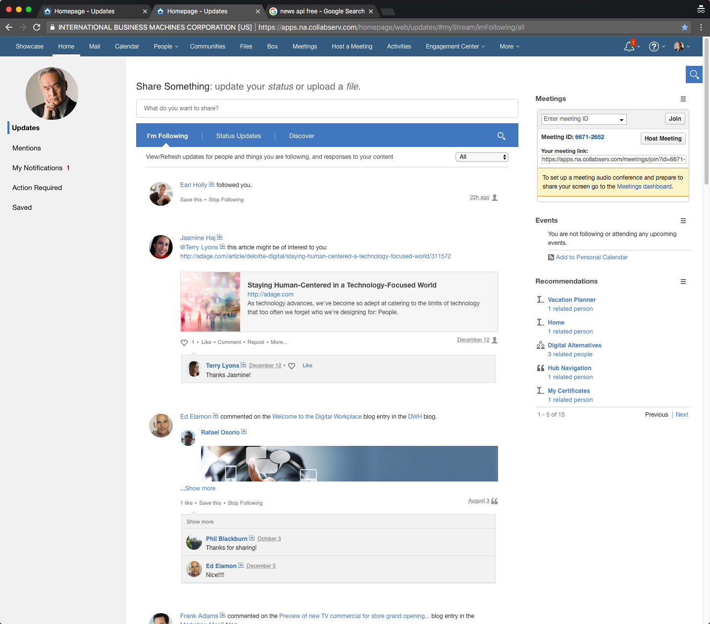
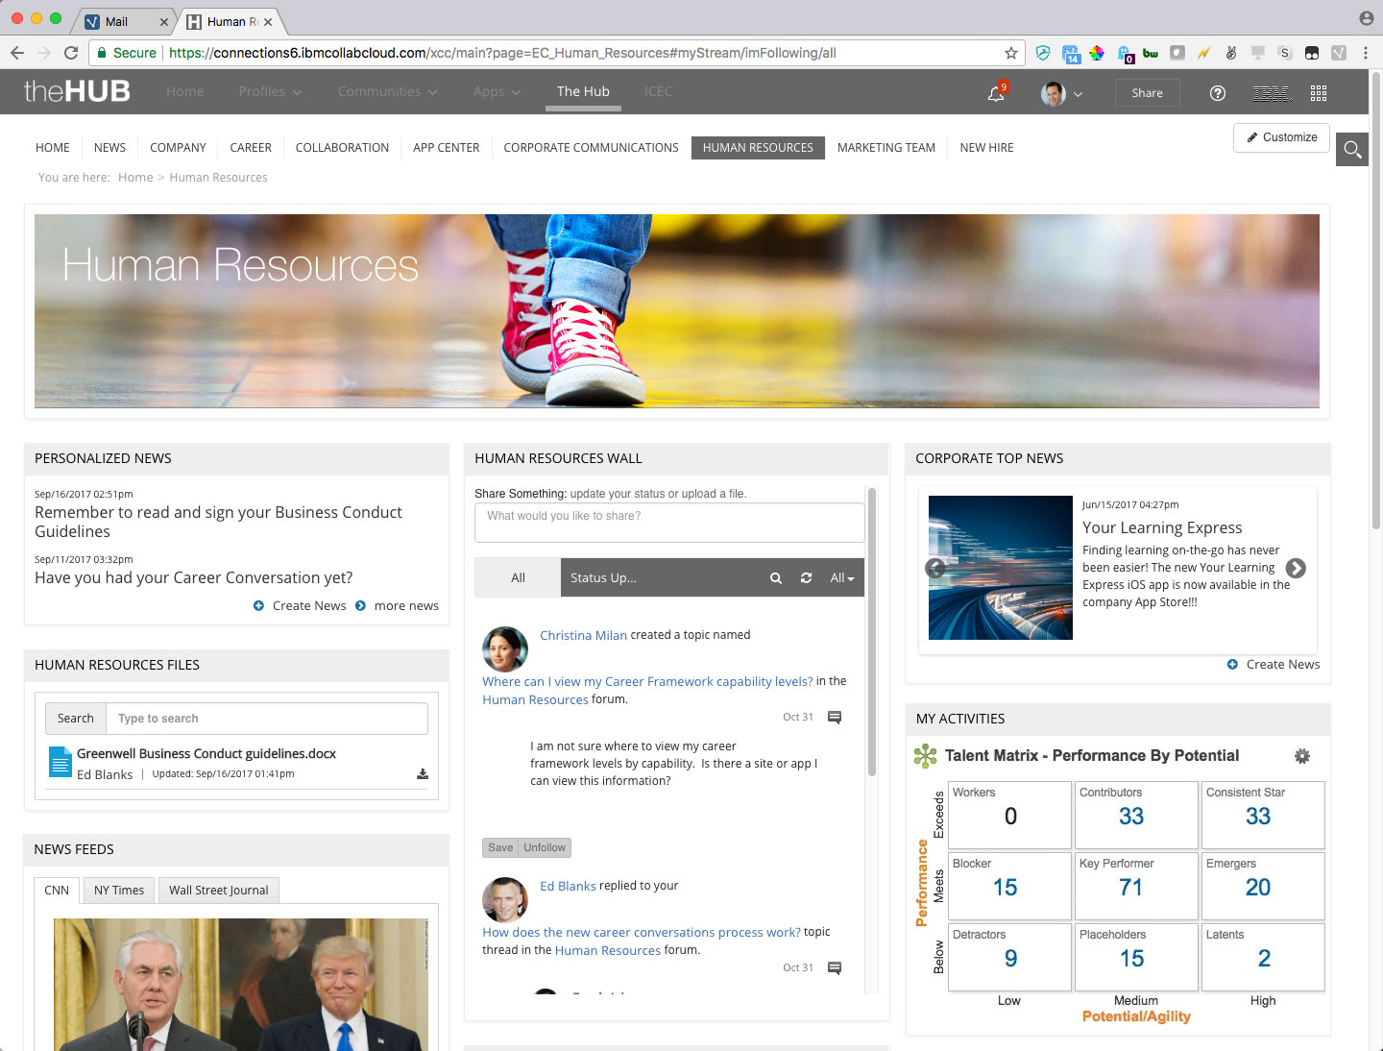
Connections vs ICEC: what’s the difference?
Connections is its own data source, and presents its own content in a standardized UI
ICEC presents content from other sources, including Connections; has no content of its own; easily modified

Slide 11
To the lab!

Slide 12
You are: sdray@labX.ibmcollab.com Password: icec4me!

Slide 13

What you can and can’t do with Customizer
Can
Can add new functionality; hide or alter existing elements
Can add new elements to the page
Can access outside content (via AJAX, SOAP, etc.)
Can retrieve Connections content (e.g., my Communities, my Files)
Can access browser data (cookies, localStorage, sessionStorage)
Can add CSS and JS libraries from Org Extensions settings
Cannot
Doesn’t work in the Connections mobile app
Doesn’t work on Meetings, Mail, Calendar, or Admin pages
Doesn’t work in ICEC

Slide 14
Questions?

Slide 15
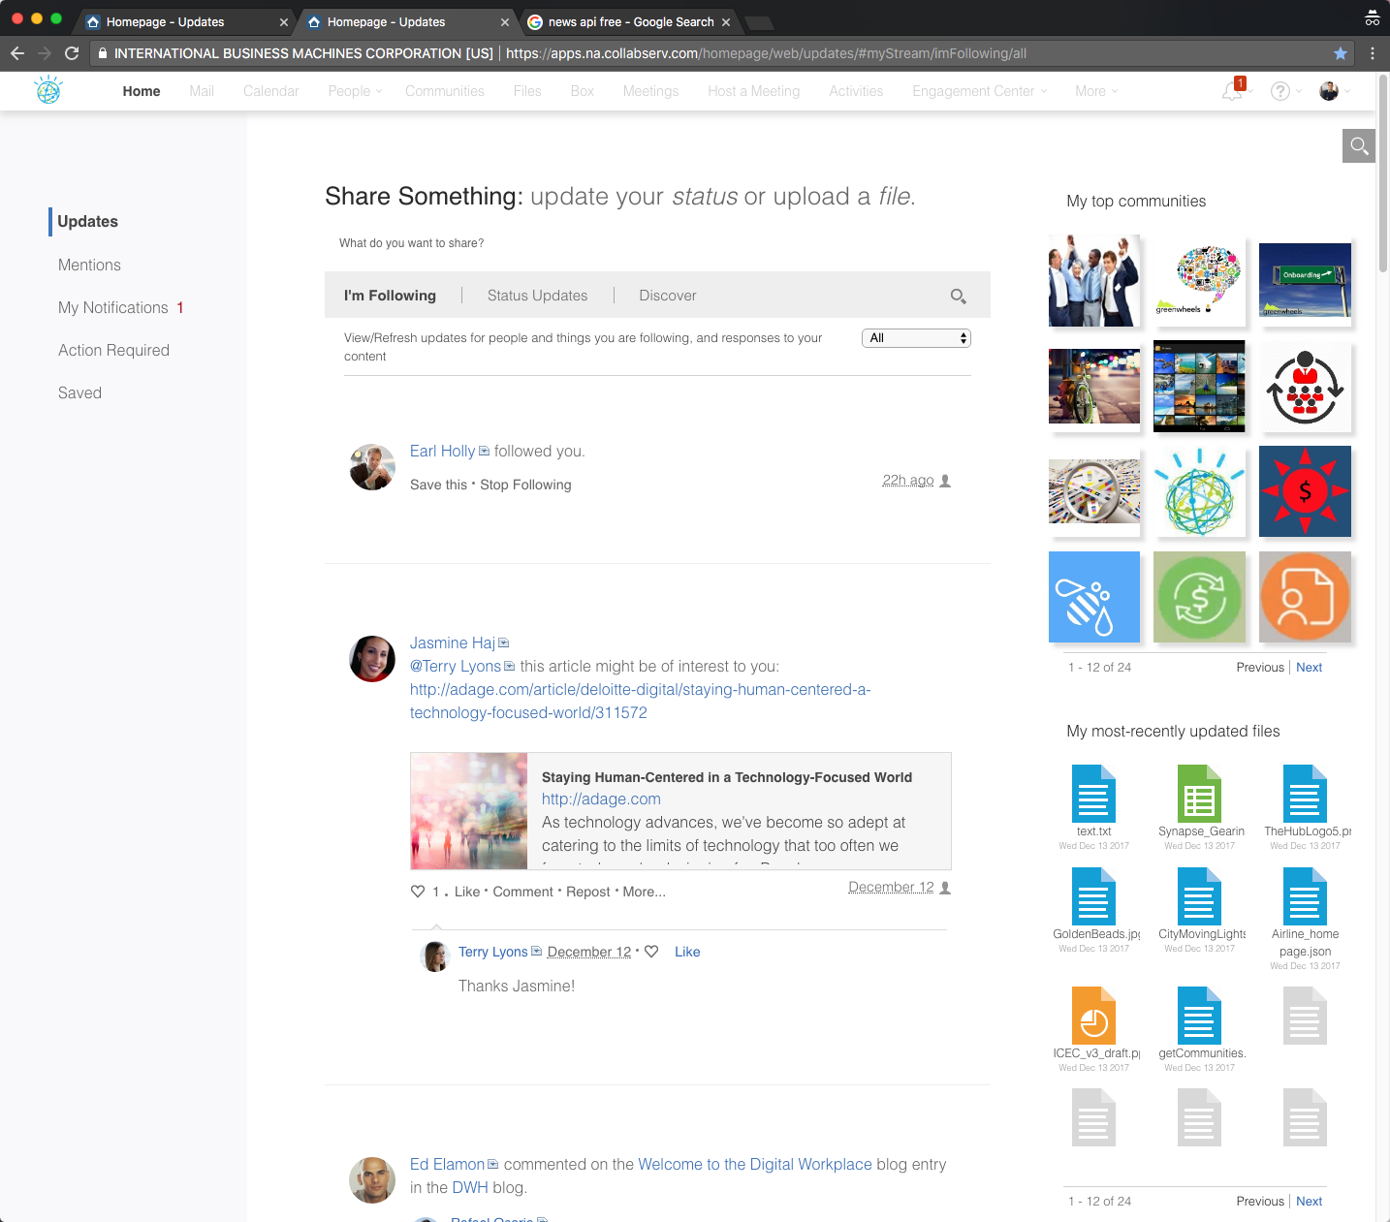
“Apple UI”
john.morrison@llshowcase.com (Sh0wcaseIBM)
Applies to (mostly) all pages
Not Meetings, Calendar, Mail, or Admin
Menu bar lightened
Watson logo inserted
User photo hidden
Fonts changed & enlarged
White space added throughout
Meetings & Events hidden
Communities & Files added

Slide 16
“Airplane UI”
earl.holly@llshowcase.com (Sh0wcaseIBM)
Applies to homepage only
All of Apple UI changes
New color theme, background image, animated background (the jet)
Text labels replaced with images (to get script look)
Logo added bottom left
Communities/files flipper
Airline news is a live external query
Outside widgets were added
Weather, stock prices
Uses cookies
To remember airline stock selected

Slide 17
“ICEC UI”
andrea.ellison@llshowcase.com (Sh0wcaseIBM)
Uses Customizer to match the look-and-feel of Connections to the modified ICEC UI
Changes colors and fonts
Retains much of the Connections layout (but that could be changed, too)
Cannot change some pages
Mail
Calendar
Meetings
Box
BUT, it improves the overall experience when users exit ICEC and enter communities, retrieve files, or create activities

Slide 18
Today’s agenda…
?
A mercifully quick (but understandable) overview of Customizer
Demo! Demo! Demo!
Three examples of highly-modified Connections environments using Customizer (that you can use, too)
Usage
How do you set it up?
How do you make changes?
Limitations
What you can (and can’t) do with Customizer
What you probably shouldn’t do with it

Slide 19
Thank you!
Scott Good
NA Above-Market Technical Sales
scott.good@us.ibm.com

